Slide 1




AT82.02
Data Modeling and Management
Lab5: Key-Value Store [NoSQL]

Slide 2
Outline
Key-Value Store
What is Redis ?
Redis Data Types
Use Cases: Shopping Cart
Notes:
https://www.sqltutorial.org/seeit/
Show use case using redis to implement a shopping cart system

Slide 3
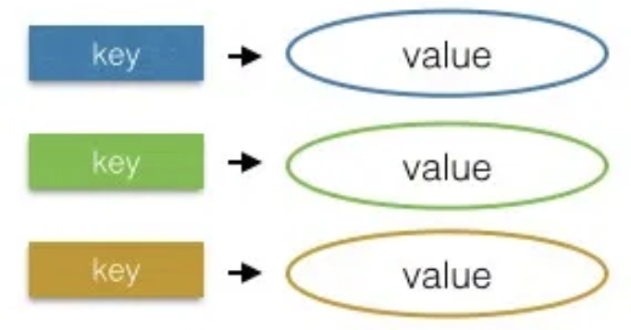
Key-Value Store
What is key-value stores ?
A key-value store is a type of nonrelational database (NoSQL).
Data is represented as a collection of key–value pairs.
Collect data as a hash table with a unique key and a pointer to a particular item of data
How do key-value stores work?
Key-value stores have no query language.
Retrieve and update data using simple get, set and delete commands
Notes:
Let’s start to the first type of NOSQL Database => Key-Value Store
It focused on high performance, availability and scalability by storing the data in the distribution storage system
Data model used in key-value store is represented as a collection of key–value pairs.
Key-value stores have no query language but it provide the set of operations for manage the data . you can use simple operation such as get , set and delete command

Slide 4
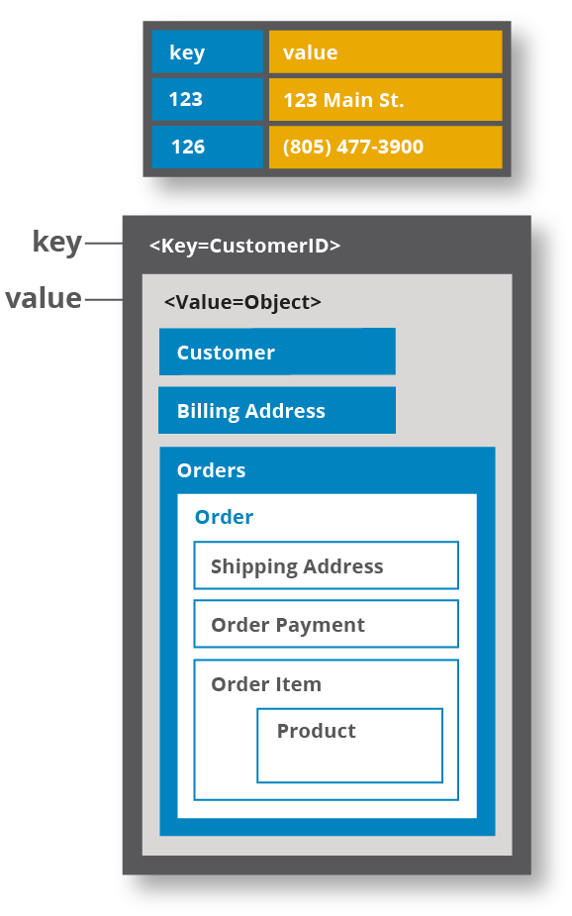
Key-Value Store
The key could be anything, but it need to be the unique identifier for an item of data
A value is either the data being identified that could be anything including a list or another key-value pair.
Key-value stores are flexible and offer very fast performance for reads and writes
Not adequate for complex applications
Notes:
The key is a unique identifier associated with data item and it used to located the data item
The value is the data item and it can have very different format depending on the database software
Key-value stores are flexible and offer very fast performance for reads and writes
However, key-value store not adequate for complex applications

Slide 5



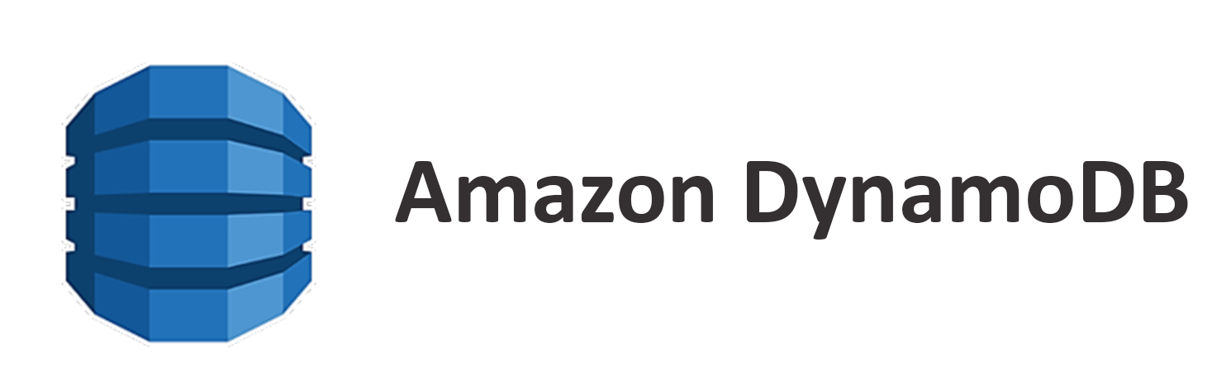

Key-Value Store
Some popular key-value stores are:

Slide 6
What is Redis?
A Key-Value Store.
Stores and manipulates all data in memory that can be used as a database, cache, and message broker.
Supports basic data structures such as strings, hashes, lists, sets, and sorted sets with range queries.
More advanced data structures like bitmaps, hyperloglogs, and geospatial indexes with radius queries are also supported.

Slide 7
How to install Redis?
Go to https://redis.io/download, download and extract file. For windows, download the stable version at https://github.com/MSOpenTech/redis/releases
Start Redis using command: $ src/redis-server
Check Service: $ src/redis-cli ping PONG
Try Redis:
Interactive Tutorial: https://try.redis.io/
Notes:
The redis project does note officially support Windows
I will use redis in online version. Just a demo,

Slide 8
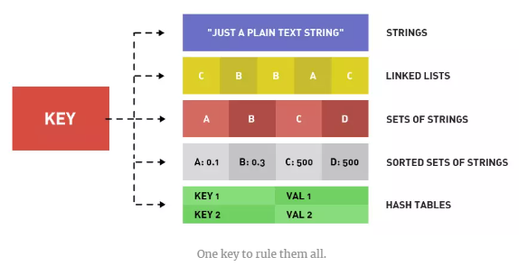
Redis Data Types
STRING: Binary-safe string data with max allowed size 512 MB
LIST: Lists in Redis are implemented using a linked list. They are collections of string elements, sorted by insertion order.
SET: A collection of unique strings with no ordering.
SORTED SET: A collection of unique strings ordered by user defined scoring
HASH: Unordered hash table of keys to values
Redis Command: https://redis.io/commands
Notes:
https://www.slideshare.net/arthurshvetsov/redis-basics

Slide 9
Redis STRING
Redis String type is the simply type of value. Integer and float number can be stored as STRING type in Redis.
Key name
Type of value
username
STRING
jamesbond007
Command | Meaning
SET | Set the value stored at the given key
GET | Retrieves the data stored at the given key
DEL | Delete the value stored at the given key (use for all types)
Value stored
Note: MSET and MGET commands are used to set or retrieve the value of multiple keys in a single command
Notes:
The ability to set or retrieve the value of multiple keys in a single command is also useful for reduced latency. For this reason there are the MSET and MGET commands:
When MGET is used, Redis returns an array of values.

Slide 10
Redis STRING example
> SET username Anna OK
> GET username “Anna”
> DEL username (integer) 1
> MSET a 10 b 20 c 30 OK
> MGET a b c 1) "10“ 2) "20“ 3) "30"
> SET view_count 10 OK
> INCR view_count (integer) 11
> INCR view_count (integer) 12
> INCRBY view_count 20 (integer) 32
Notes:
in case, if you want to collect the view_count on your web page. you can use command. like this
SET view_count as 10
Redis provide INCR command to increment the number stored at key by one
10 + 1 => 11
Everytime user go to the web page. The view_count will plus +1 .In this case , you can use command INCR
-> 10+1 => 11
-> 11+1 => 12
-> INCRBY view_count 20
-> 12 + 20 => 32

Slide 11
Redis LIST
Redis LIST is a sequence of order string, implemented using Linked List
Key name
Type of value
name-list
LIST
Jane
Anna
Jane
Command | Meaning
RPUSH / LPUSH | Pushes the value onto the right/left end of list
RPOP / LPOP | Pops the value from the right/left end of list and return it
LRANGE | Retrieves a range of values from the list
LINDEX | Retrieves the value at a given position in the list
LLEN | Return the length of a list
List of values, duplicates possible

Slide 12
Redis LIST example
> RPUSH name-list Jane (integer) 1
> RPUSH name-list Anna (integer) 2
> LPUSH name-list Jane (integer) 3
> LRANGE name-list 0 -1 1) "Jane" 2) "Jane" 3) "Anna"
> LINDEX name-list 2
“Anna”
> LPOP name-list “Jane” > LRANGE name-list 0 -1 1) "Jane" 2) "Anna"
Notes:
The ability to set or retrieve the value of multiple keys in a single command is also useful for reduced latency. For this reason there are the MSET and MGET commands:
When MGET is used, Redis returns an array of values.

Slide 13
Redis SET
Redis SET is a sequence of strings like Redis LIST , but Redis set collects unique strings with no ordering.
Key name
Type of value
name-set
SET
Jane
Anna
John
Command | Meaning
SADD | Adds the value to the set
SMEMBERS | Returns the entries set of values
SISMEMBERS | Check of the value is in the set
SREM | Remove the value from the set, If it exists
set of distinct values with no ordering
Notes:
The ability to set or retrieve the value of multiple keys in a single command is also useful for reduced latency. For this reason there are the MSET and MGET commands:
When MGET is used, Redis returns an array of values.

Slide 14
Redis SET example
> SMEMBERS name-set 1) "Jane" 2) "Anna" 3) "John" > SISMEMBER name-set Pang (integer) 0
> SISMEMBER name-set Anna (integer) 1 > SREM name-set Anna (integer) 1
> SADD name-set Jane (integer) 1 //success
> SADD name-set Anna (integer) 1
> SADD name-set John (integer) 1
> SADD name-set Jane (integer) 0 //cannot add duplicate value
Notes:
The ability to set or retrieve the value of multiple keys in a single command is also useful for reduced latency. For this reason there are the MSET and MGET commands:
When MGET is used, Redis returns an array of values.

Slide 15
Redis SORTED SET (ZSET)
Redis SORTED SET is a collection of unique strings ordered by user defined scoring. Every element in a sorted set is associated with a floating-point value (called score)
Key name
Type of value
Command | Meaning
ZADD | Adds the value with the given score to the ZSET
ZRANGE | Retrieves the values in the ZSET from their position in the sorted order
ZRANGEBYSCORE | Retrieves the values in the ZSET based on a range of scores
ZREM | Remove the value from the ZSET, If it exists
name-zset
ZSET
Jane 12
Anna 28
Members, ordered
by associated score
Scores, ordered
by numeric value
Notes:
The ability to set or retrieve the value of multiple keys in a single command is also useful for reduced latency. For this reason there are the MSET and MGET commands:
When MGET is used, Redis returns an array of values.

Slide 16
Redis SORTED SET (ZSET) example
> ZADD name-zset 12 Jane (integer) 1 //success
> ZADD name-zset 28 Anna (integer) 1
> ZADD name-zset 28 Anna (integer) 0 //cannot add duplicate value
> ZRANGE name-zset 0 -1 withscores 1) "Jane" 2) 12.0 3) "Anna" 4) 28.0 > ZREM name-zset Anna (integer) 1
> ZRANGE name-zset 0 -1 withscores 1) "Jane" 2) 12.0
Notes:
The ability to set or retrieve the value of multiple keys in a single command is also useful for reduced latency. For this reason there are the MSET and MGET commands:
When MGET is used, Redis returns an array of values.

Slide 17
Redis HASH
Redis HASH is a collection of key-value pairs. The value which stored in HASH can be strings and numbers.
Key name
Type of value
Command | Meaning
HSET | Stores the value at the key in the hash
HGET | Retrieves the value at the given hash key
HGETALL | Retrieves the entire hash
HDEL | Remove the key from the hash, if it exists
HLEN | Returns the number of fields contained in the hash stored at key.
customer-hash
HASH
name Jane
email jane@gmail.com
Distinct keys, with no ordering
Values associated with the key
Note: HMSET and HMGET commands are used to set or retrieve the value of multiple keys in a single command
Notes:
Sets field in the hash stored at key to value. If key does not exist, a new key holding a hash is created. If field already exists in the hash, it is overwritten.
Sets the specified fields to their respective values in the hash stored at key. This command overwrites any specified fields already existing in the hash. If key does not exist, a new key holding a hash is created.

Slide 18
Redis HASH example
> HSET customer-hash name Jane (integer) 1 //success
> HSET customer-hash email jane@gmail.com (integer) 1
> HGET customer-hash name "Jane“
> HLEN customer-hash 2
> HGETALL customer-hash 1) "name“ 2) "Jane“ 3) "email“ 4) "jane@gmail.com" > HDEL customer-hash email (integer) 1
> HGETALL customer-hash 1) "name“ 2) "Jane“

Slide 19

Use Case: Shopping Cart
1.Admin add new products into AIT shopping website for three items as follows.
Product ID | Name | Price | Category
POO1 | ML Textbook | 300 | book
P002 | DMM Textbook | 250 | book
P003 | Pencil | 15 | stationery
P001
HASH
P002
HASH
P003
HASH
product_id P001
name ML Textbook
price 300
category book
product_id P002
name DMM Textbook
price 250
category book
product_id P003
name Pencil
price 15
category stationery
Notes:
Part3: In this part, we show the use case to apply Redis for caching in shopping cart system by moving login and visitor sessions from relational database to Redis.

Slide 20
Use Case: Shopping Cart (2)
Create Product 1 in HASH: use command HSET and set P001 as a key. > HSET P001 name "ML Textbook" > HSET P001 price 300 > HSET P001 category "book"
Create Product 2 in HASH: use command HSET and set P002 as a key. > HSET P002 name "DMM Textbook" > HSET P002 price 250 > HSET P002 category "book"
Create Product 3 in HAS : use command HMSET and set P003 as a key. > HMSET P003 name "Pencil" price 15 category "stationery"
Notes:
Part3: In this part, we show the use case to apply Redis for caching in shopping cart system by moving login and visitor sessions from relational database to Redis.

Slide 21
Use Case: Shopping Cart (3)
Customer
Cart_product
Customer ID | Name | Address
C1 | Jane | AIT
C2 | Anna | AIT
Customer ID | Product ID | Quantity
1 | P001 | 1
1 | P002 | 1
2 | P003 | 2
P001:1
cart:C1
customer:C1
P002:1
cart:C2
P003:2
customer:C2
Product ID
Quantity
Notes:
Part3: In this part, we show the use case to apply Redis for caching in shopping cart system by moving login and visitor sessions from relational database to Redis.

Slide 22

Use Case: Shopping Cart (3)
customer:C1
HASH
customer:C2
HASH
id C1
name Jane
address AIT
id C2
name Anna
address AIT
Customer
cart:C1
SET
cart:C2
SET
P001:1
P002:1
P003:2
Shopping Cart
Notes:
Part3: In this part, we show the use case to apply Redis for caching in shopping cart system by moving login and visitor sessions from relational database to Redis.

Slide 23
Use Case: Shopping Cart (4)
2. Jane and Anna would like to register to AIT shopping website. She fills out her information in the registration form including name and address. Create User: use command HSET
> HSET customer:C1 id C1 > HSET customer:C1 name Jane > HSET customer:C1 address AIT
Create User: use command HMSET > HMSET customer:C2 id C2 name Anna address AIT 3. After admin approve, Jane go to AIT shopping website and pickup new products into her shopping cart. Get all data in Hash: use command HGETALL
> HGETALL customer:C1
Notes:
Part3: In this part, we show the use case to apply Redis for caching in shopping cart system by moving login and visitor sessions from relational database to Redis.

Slide 24
Use Case: Shopping Cart (5)
Add product P001 with quantity= 1 in a SET: use command SADD > SADD cart:C1 P001:1 Add product P002 with quantity= 1 in a SET : use command SADD > SADD cart:C1 P002:1
Get all product in a cart using SMEMBERS
> SMEMBERS cart:C1 1) "P002:1" 2) "P001:1"
4. Jane change her mind. She would like to buy only "DMM Textbook" , so she delete "ML Textbook" in his shopping cart. Delete "ML Textbook" at product id P001 in a cart with command SREM. > SREM cart:C1 P001:1
Notes:
Part3: In this part, we show the use case to apply Redis for caching in shopping cart system by moving login and visitor sessions from relational database to Redis.

Slide 25
Use Case: Shopping Cart (6)
5. She checks all her orders in shopping cart again and prepare for payment.
Get all data in a cart (collected in SET): use command SMEMBERS
> SMEMBERS cart:C1 1) "P002"
> HGETALL P002 1) "name" 2) "DMM Textbook" 3) "price“ 4) "250" 5) "category" 6) "book"
After finish payment process, all data in a cart will be deleted.
> DEL cart:C1
Notes:
Part3: In this part, we show the use case to apply Redis for caching in shopping cart system by moving login and visitor sessions from relational database to Redis.

Slide 26
References
Introduction of Redis data types: https://matt.sh/introduction-to-redis-data-types
Redis Data Types: https://www.tutorialspoint.com/redis/redis_data_types.htm
Redis command: https://redis.io/commands
Interactive tutorial: http://try.redis.io/
Install-cli-comands and data types: https://auth0.com/blog/introduction-to-redis-install-cli-commands-and-data-types/
The ReJSON Redis Module: http://rejson.io/
https://www.slideshare.net/arthurshvetsov/redis-basics

Slide 27

Thank you.

Slide 28
Use Case: Shopping Cart (3)
Customer
Redis Model
Customer ID | Name | Address
C1 | Jane | AIT
C2 | Anna | AIT
> SET cart:C1 → (P001:1 ,P002:1) > SET cart:C2 → (P003:2)
> HASH customer:C1 {id: “C1”, name: “Jane”, Address: “AIT”} > HASH customer:C2 {id: “C2”, name: “Anna ”, Address: “AIT”}
Cart_product
Customer ID | Product ID | Quantity
1 | P001 | 1
1 | P002 | 1
2 | P003 | 2
P001:1
cart:C1
customer:C1
P002:1
cart:C2
P003:2
customer:C2
Notes:
Part3: In this part, we show the use case to apply Redis for caching in shopping cart system by moving login and visitor sessions from relational database to Redis.

